Slide 1
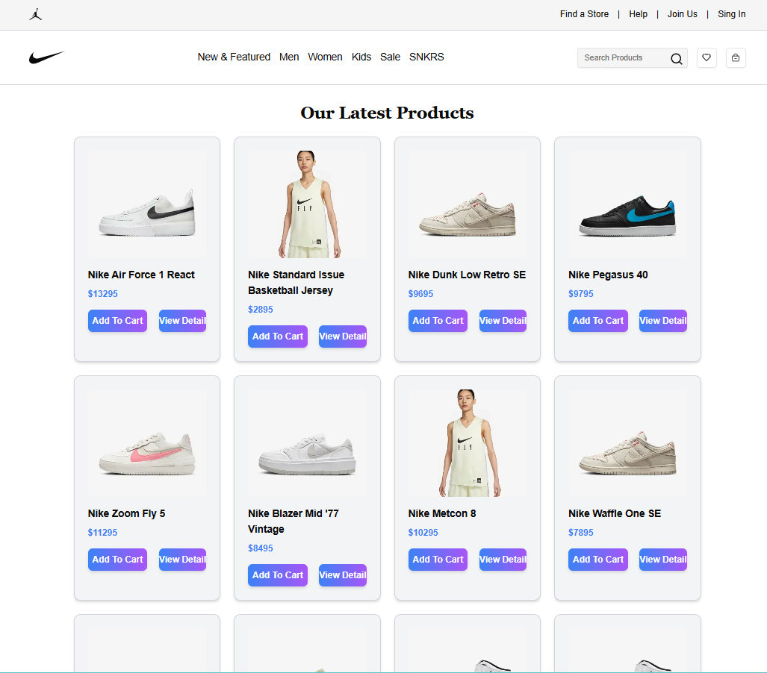
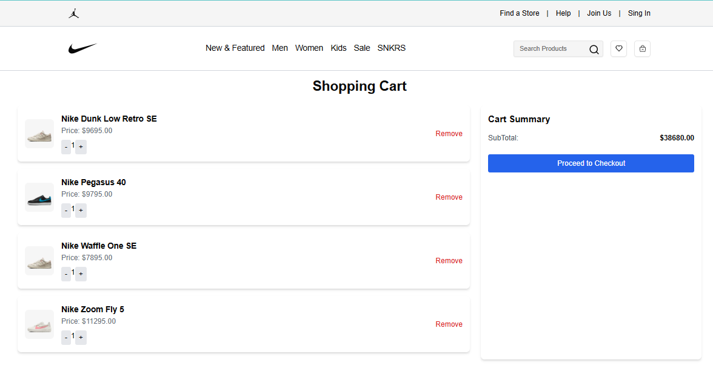
Day 4 – Dynamic frontend Component General E-commerce Website
TAJ MART
1.DYNAMIC PRODUCT CATEGORY:
2.CART PAGE:

Slide 2
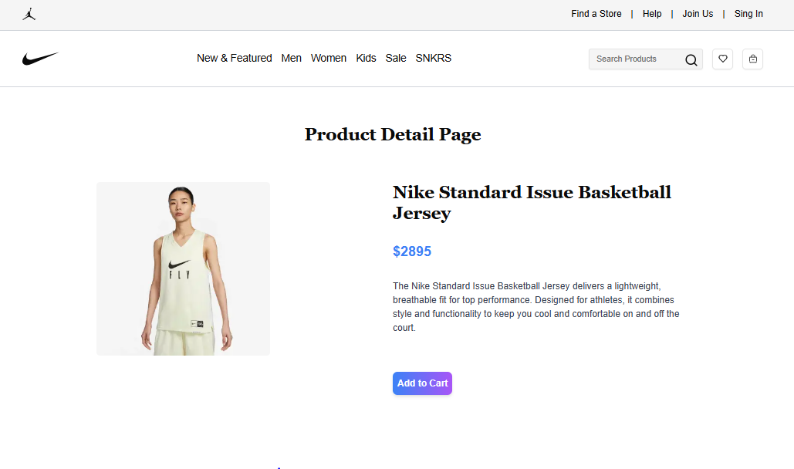
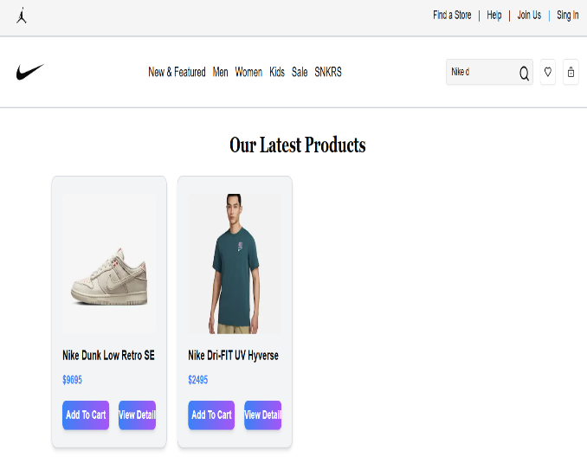
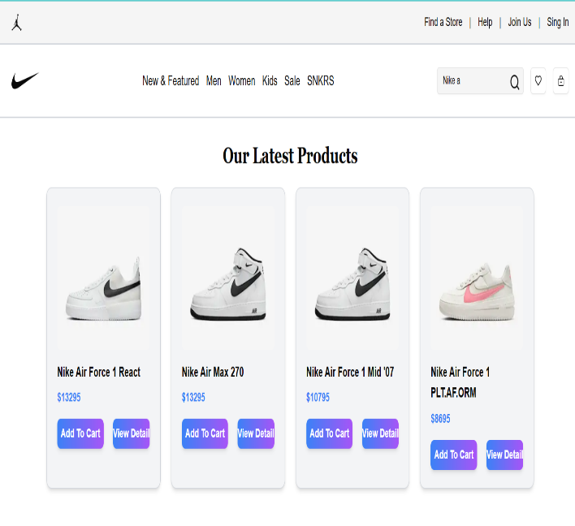
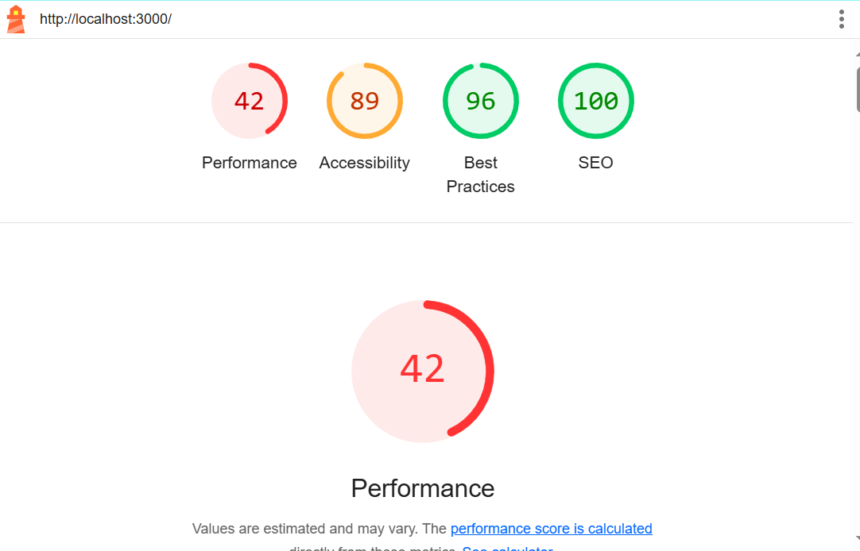
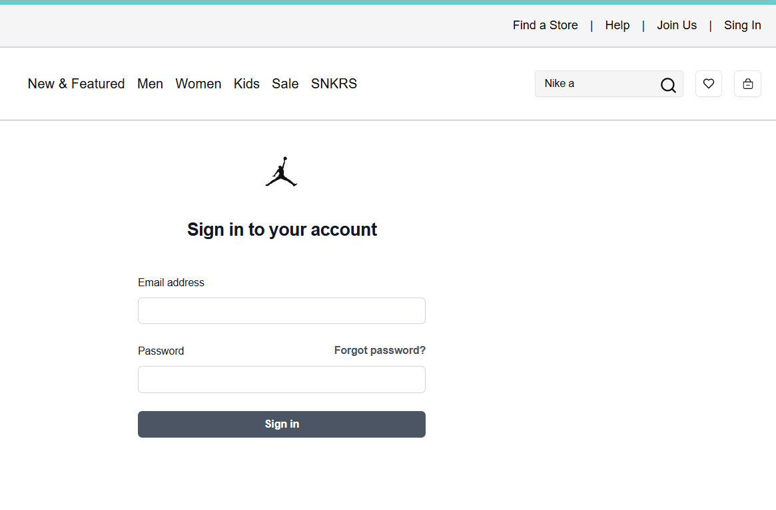
4. SEARCH BAR COMPONENT:
3.DYNAMIC PRODUCT DETAIL:
5. CART FUNCTIONALTY:
6.USER SINGUP COMPONENT:

